Slide 1
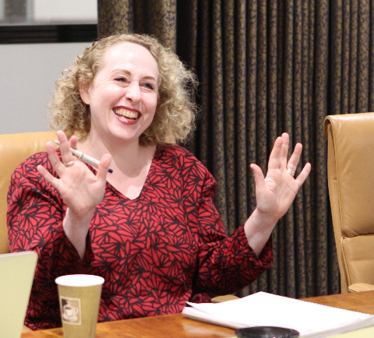
Introductions
Emilia Frost
Who are you?
What do you do?
Where are you based?

Slide 2
Creating digital resources: GDPR, copyright and using open licences
Digital Skills for Heritage is our ambitious three-year initiative to increase digital capability across the diverse UK heritage sector. It is a DCMS supported four year, £4M campaign
We have longstanding digital requirements that apply to all projects, designed to ensure we get the best possible value from the projects we fund
We updated our licensing requirement in 2020 and commissioned guidance for the sector
Our new tool kit from copyright expert Naomi Korn is designed to tackle specific, complex issues relating to GDPR and privacy rules that we know some projects face.
Josie Fraser, Head of Digital Policy
Notes:
Josie Fraser, Head of Digital Policy
The Coronavirus (Covid-19) Pandemic has made the need for organizations to understand and make use of digital more pressing than ever before. The National Heritage Lottery Fund recognizes what a critical role digital confidence and skills can play at the best of times in supporting communications, connection and creativity. An investment in digital skills is an investment for the future.
The National Lottery Heritage Fund is committed to making heritage more inclusive and accessible to a wider range of people and this includes the younger generations. Children and young people have in important role to play in caring for, creating, and protecting heritage now and in the future. Heritage can provide children and young people with exciting and innovative ways to unleash their imaginations and creativity – and through heritage children and young people can take a journey through generations and critically unpack the world around them. We are prod to invest in heritage projects that support children and young people’s engagement with Heritage, including our £10m Kick the Dust programme. Our Policy lead on Children and Young People is Sarah Lanchin.

Slide 3
House keeping
Mute microphones
Videos welcome
30 minute presentation
Q&A at the end via chat box
Netiquette!
Notes:
COVID-19 has an enormous and perhaps irreparable impact on the retail sector worldwide, with social distancing requirements, lockdowns and dwindling sales pushing many to bankruptcy and expediting the shift away from physical stores to digital shopping. It has been estimated that the pandemic has expedited the move towards digitalisation by at least five years. It is expected that department stores for example experienced a decline of over 60% for 2020, while in tandem e-commerce saw growth of at least 20%. The marked decrease in sales from physical stores has pushed large department stores such as Century 21 into administration, while small businesses unable to survive in the online environment are unlikely to survive the pandemic.
A 2019 study estimated that digitalization is integral to greater than 15% of global GDP, and with the current pandemic this is likely to increase to as much as 50% by 2023 further reinforcing the need for businesses to embrace digitalization in order to weather the pandemic and ensure rapid recovery. Another consequence to the retail sector on disruption of tradition supply chains has been the importance of a more localised supply chain, supporting the local economy and increase the brand awareness and brand value of more localised retailers, in a way countering to some extent the gradual death of the high street (main shopping street) in the UK and in many other countries worldwide.
Analysis:
Despite the challenges facing the retail industry, there have been several success stories in the retail sector, most notably e-retail platform such as Ocado, Amazon as well as food delivery services such as Uber Eats, Deliveroo and Just Eat. These platforms have grown from strength to strength with large portions of the population now doing most of their shopping online. Although items such as clothing saw a decline in sales overall, other items such as groceries, PPE, alcohol, entertainment, home improvement or construction materials grew by 10%-15%, largely due to people isolating due to lockdowns. Many companies have pivoted to this new normal in two main ways, by offering online ordering with the order then shipped to the customer, or via a “buy online and pick-up in store” or “click and collect” option, where the item is simply collected at the store entrance, with minimum interaction Amazon has experienced a 40% sales growth in 2020 due to the pandemic, whilst US based Walmart saw a 97% increase in its e-commerce sales in Q2 of 2020 alone. In order to meet these increasing requirements many of these companies have developed new technical innovations, both in terms of e-commerce platforms and user interfaces but also modes of processing and delivering such high volumes of online orders, such as multi-channel distribution approaches, providing greater flexibility and less reliance on a single point of the supply chain. We note however, that the increased exposure for business through digitalization and ecommerce also increases their exposure to potential counterfeiting and IP theft, and as such the traditional focus on protection of registered rights and employee know-how may be insufficient with a pivot towards cyber security becoming increasingly important. It is also increasingly vital that as businesses “go digital” and either turn to ecommerce platforms or develop their own software solutions, that where open source code has been used that they understand their responsibilities and obligations when using the code, especially when looking to commercialize their own solution containing open source software.
Ocado, a leading provider of grocery delivery and logistics, is a good example of a business, which on the face of it is just an online supermarket, but which through its innovations and licensing of its IP to third parties creates additional value for the company, while at the same time fostering innovation in adjacent areas through its venture program, supporting and acquiring disruptive technologies. This is achieved by Ocado expanding its patent portfolio, which now covers innovations relating to its core competencies surrounding AI and machine learning, robotics, IoT and edge intelligence, simulation, modelling and forecasting. In this way, Ocado uses its IP as a foundation layer for a wider defensive strategy, and business model, while at the same time ensuring the business knows what others are doing, what impact this has on Ocado and how the company should react.
In the meantime, home delivery giants such as Amazon have amassed a large patent portfolio some of which are relevant to the e-retail sector and topics such as drones, drone noise reduction, order management systems, mobile loading platforms, and autonomous vehicles to name a few. Ocado have also recently shown their interest in autonomous vehicle technology for self-driving vans through a $13.8m investment in autonomous vehicle technology company Oxbotica. The use of drone technology for deliveries is now beginning to extend beyond large behemoths such as Amazon, with start-ups such as Manna in Ireland trialling grocery and medicine deliveries with supermarket chain Tesco, which estimates the market to be worth £10 billion in the UK alone over the coming years. UK chain Asda, owned by giant Walmart, is also planning to trial drone delivery using drone firm Flytrex. It is clear that the field of automation and improved logistics will be needed to improve the ever-increasing e-commerce market and with that many large companies are developing new innovations to meet the demand. However, these will be supported largely by the true innovators in small business, which will need to carefully protect their innovations moving forward in order to maintain a position for themselves in this growing eco system.

Slide 5
Creative Commons Licences: A Guide to Data Protection & Copyright
Naomi Korn
CEO & Founder, Naomi Korn Associates

Slide 6
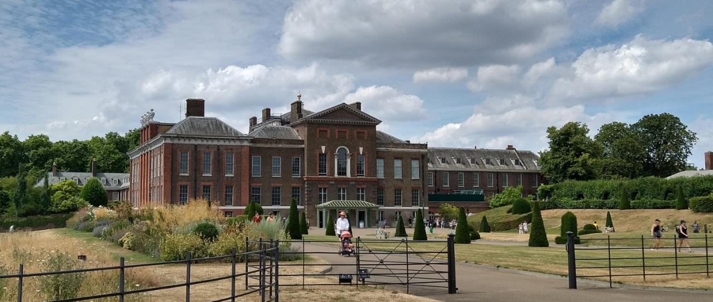
Emilia Frost
Copyright
The contents of this presentation are ©Naomi Korn Associates, 2023. Some Rights Reserved.
Disclaimer:
The information provided within this presentation is an opinion and should not be construed as legal advice.

Slide 7
Naomi Korn Associates is a UK-based leader specialising in copyright, data protection, and licensing. Since 2003, we have worked with the cultural, heritage, charity, education and private sectors across the UK and internationally.
We support our clients to comply with the law. We also help them to exploit their assets commercially through better rights and privacy management. We do this by integrating our legal, commercial, information governance and technical expertise into our clients' practices.
The team, headed up by Naomi Korn, Founder and CEO, brings together a range of world-renown specialists who have built a reputation of excellence amongst charities, education, and cultural heritage.
Who we are

Slide 8
Copyright - where do we need to be? Continued…
Social media
The commission
Naomi Korn Associates were commissioned by the National Lottery Heritage Fund to develop and produce a Toolkit to support the National Lottery Heritage Fund projects understand and ethically manage openly licensed materials.
The resulting Toolkit deals with Creative Commons Licences, copyright and data protection!
Photo by Naomi Korn
Photo by Emilia Frost
Emilia Frost

Slide 9
Today’s Objectives
Gain an overview of Creative Commons Licences and the Heritage Fund’s CC BY licensing requirement
Learn the basics of copyright, what is protected and who owns what rights.
Understand data protection key issues as they relate to digital outputs
Gain an understanding of how to navigate these issues using the templates and tools that we have produced in the Toolkit

Slide 10
The context
Projects funded by the National Lottery Heritage Fund are required to meet the open licensing requirement of a Creative Commons CC BY 4.0 licence.
Copyright and data protection obligations can present interrelated complex areas that some projects will need to navigate to fulfil their Creative Commons licensing requirements.

Slide 11
Creative Commons Licences
CC 0
CC BY
CC BY S
CC BY NC
CC BY ND
CC BY NC SA
CC BY NC ND
Photo by Naomi Korn
Photo by Naomi Korn

Slide 12
Introduction to copyright
Copyright, Designs and Patents Act 1988
Automatic
Original
Exclusive right to permit (or not) others from:
Copying
Broadcasting
Performing
Disseminating
Renting
Making available to the public
Communication to the public
Copyright
Financial benefits too
Text
Emilia Frost

Slide 13
Range of media types and copyright
Musical
Artistic
Films
Types of works protected
by copyright
Broadcasts
Literary
Sound
recordings
Dramatic
Typographic
Applies to digital and analogue

Slide 14
Duration of copyright
Ownership issues
Staff contributions
Organizational ownership
Freelancers, contractors, volunteers, students, public, project participants
Their copyright
BFI

Slide 15
The context
Challenges include copyright issues associated with content produced by third parties, such as contractors, volunteers and project participants.
Permission needs to be sought to reproduce any content created under the terms of a CC BY 4.0 Licence

Slide 16
Project examples
A project has received funding to create an archive of recordings from older LGBTQI+ living in the area
A charity is working with staff and local people to create a collaborative online artwork
A church is working with volunteers and young people to produce a play about their experiences of growing up
A museum is digitizing it’s archive of personal letters from military personnel involved in the Falklands conflict.
A library is creating resources for the visually impaired and has contracted the services of a specialist firm to help.

Slide 17
The data protection legislation
GDPR/Data Protection Act 2018
Covers personal data
Increased rights for data subjects
6 lawful grounds for processing: including consent
Informed consent
Increased responsibilities for “special category data”
Living identifiable individuals
More responsibilities for those processing personal data

Slide 18
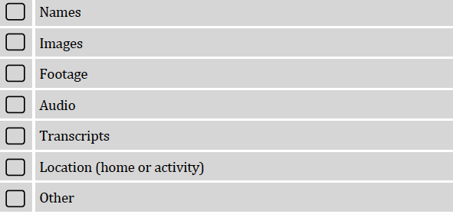
Types of personal data in digital outputs
Emilia Frost

Slide 19
Special category data

Slide 20
The context
Consent provides one of the lawful basis for personal data to be published online.
Personal data included in projects cannot be relicensed under the terms of a Creative Commons Licence.
Any subsequent use of personal data in projects is the responsibility of the user.
The National Lottery Heritage Fund provides an exemption for special category data.

Slide 21
Project examples
A project has received funding to create an archive of recordings from older LGBTQI+ living in the area
A charity is working with staff and local people to create a collaborative online artwork
A church is working with volunteers and young people to produce a play about their experiences of growing up
A museum is digitizing it’s archive of personal letters from military personnel involved in the Falklands conflict.
A library is creating resources for the visually impaired and has contracted the services of a specialist firm to help.

Slide 22
How does CC BY 4.0 apply to funded outputs?
 | Your outputs do not contain any personal data or fully anonymise the data | Your outputs contain data relating to living individuals | Your outputs contain sensitive personal data relating to matters such ethnicity, health, sexuality or relate to children or vulnerable individuals | Your outputs contain data concerning the criminal convictions, allegations or proceedings relating to living individuals
Will be able to give the outputs a CC BY 4.0 copyright licence or apply an exemption? | Yes, the CC BY 4.0 licence can be added to these outputs | Yes, the CC BY 4.0 licence can be added to these outputs | No. The Heritage Fund allows an exemption from the requirement for outputs with this type of data | No. The Heritage Fund allows an exemption from the requirement for outputs with this type of data

Slide 23
Duration of copyright
The Toolkit
https://www.heritagefund.org.uk/funding/good-practice-guidance/creating-digital-resources-gdpr-copyright-and-using-open-licences
BFI

Slide 24
Introduction to the Toolkit
Info about Creative Commons licences, data protection and copyright
Factsheets, FAQs & check lists
Template consent forms, permissions forms & take down notices
Further information about the exemption offered by the National Lottery Heritage Fund for special category data
Links and sources of advice and support.
Case studies and examples
Statement for re-users of personal data
Photo credit: Birmingham Museums Trust

Slide 25
Thank you for listening
Questions?

Slide 26
Heritage Digital – an initiative aimed to increase the amount of free digital skills training and support available to heritage organisations: www.charitydigital.org.uk/heritage-digital
Digital Heritage Hub – 100 questions answered about digital engagement, digital content, digital leadership and digital planning:
https://www.culturehive.co.uk/digital-heritage-hub/
naomikorn.com/resources
Useful resources
Emilia Frost

Slide 27
Want to find out more?
Photo by Emilia Frost
Get 30% off Information Law with code INFOLAW30
RRP: £59.95 £41.97
To order, email info@facetpublishing.co.uk and quote the code. A member of the team will be in touch to process your order
Photo by Naomi Korn
Photo by Naomi Korn

Slide 28
Thank you
Website: www.naomikorn.com
Twitter: @nkorn
Instagram: naomikornassociates
LinkedIn: Naomi Korn Associates
Email: info@naomikorn.com

