Slide 1
www.ahfund.org.uk
www.ahfund.org.uk

Slide 2
The Architectural Heritage Fund
Independent charity established 1976 as a revolving fund for heritage projects – only specialist heritage lender in the UK
Loans since 1976, grants since 1990, plus free advice and capacity building for sector
Promotes the role of historic buildings and structures in community-led regeneration, liaises with key stakeholders
Ongoing support to >250 projects a year, urban and rural, usually in partnership with other funders
Network of officers throughout the UK providing advice and guidance to communities that wish to repair and adapt buildings and structures at risk
www.ahfund.org.uk

Slide 3
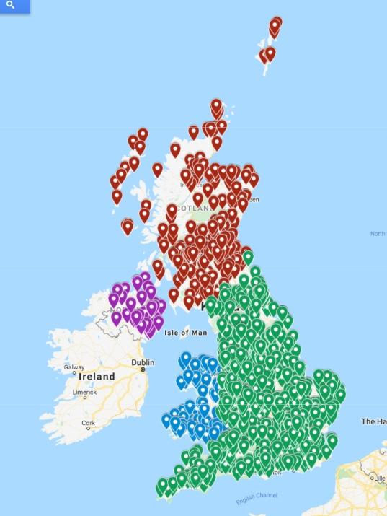
Our Support
Across the UK…
Grants
Nearly 2,000 different offers
> £25 million offered since 1990
Loans
Nearly 1,000 different offers
> £135 million offered since 1976
www.ahfund.org.uk

Slide 4
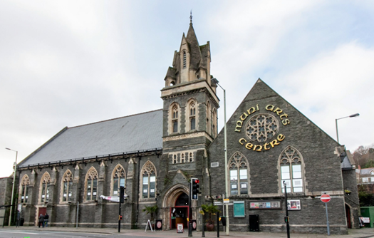
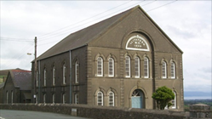
AHF Grants
Project Viability Grants
Test ideas & outline costs
Outline business planning
Decide to move forward (or not)
Project Development Grants
Develop detailed ideas & costs
Detailed business planning
Professional Fees
Capacity Building
Capital Grants
Emergency works
Test ‘meanwhile’ uses
Part of larger phase of work
* Please visit our website for latest grant availability www.ahfund.org.uk
www.ahfund.org.uk

Slide 5
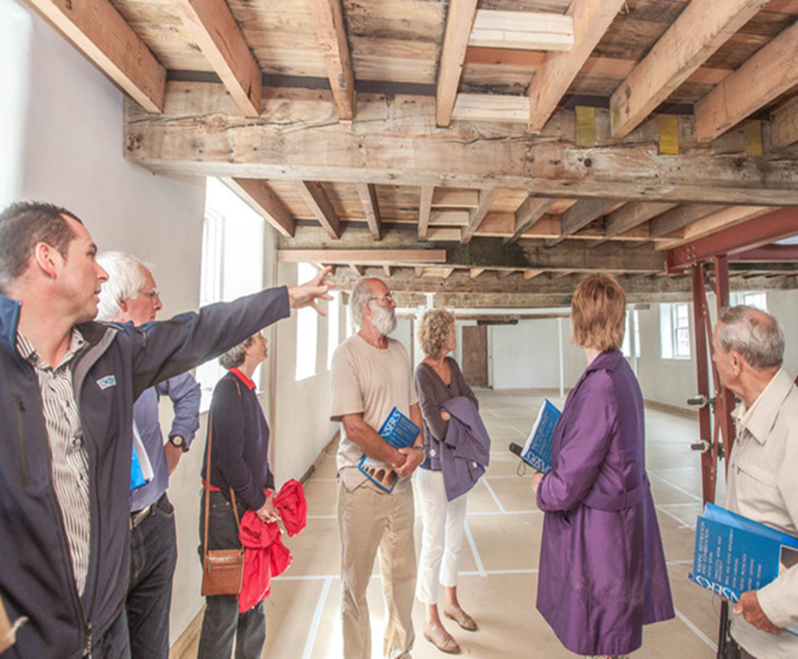
AHF Loan Funds
Heritage Impact Fund (HIF) &
Endowment Fund
From £20k - £1M
Uses of loan can include:
acquisition of property
working capital during on-site works
bridge fundraising gap
initial operation start up costs
Competitive Interest rates and fees dependent on available security
www.ahfund.org.uk

Slide 6
Capacity Building Programmes
RePlan
For existing loan clients of the AHF
For new loan clients of the AHF and NLHF grantees
Reach Fund
Financial planning/reporting
Business plan and modelling
Market Research
Governance
www.ahfund.org.uk

Slide 7
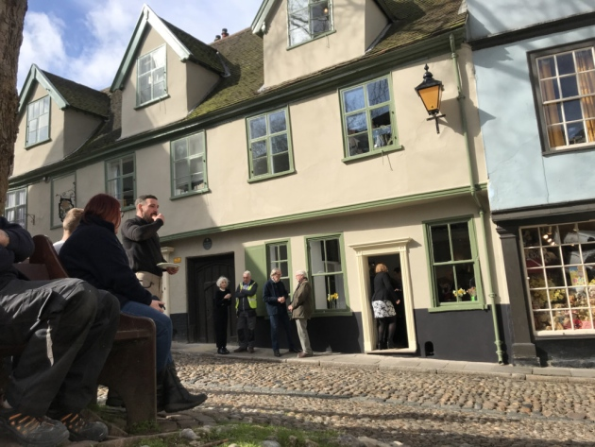
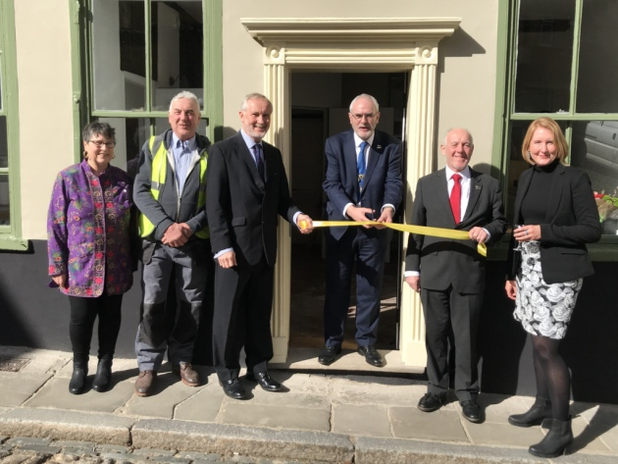
Case Study: 16 Elm Hill, Norwich Preservation Trust
AHF support to date:
PVG in 2016 £5,000
PDG in 2018 £7,500
Endowment Loan in 2020 £50,000
Grade II 16th-century town house restored by revolving fund BPT
© Victoria Pertusa

Slide 8
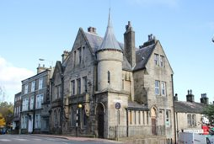
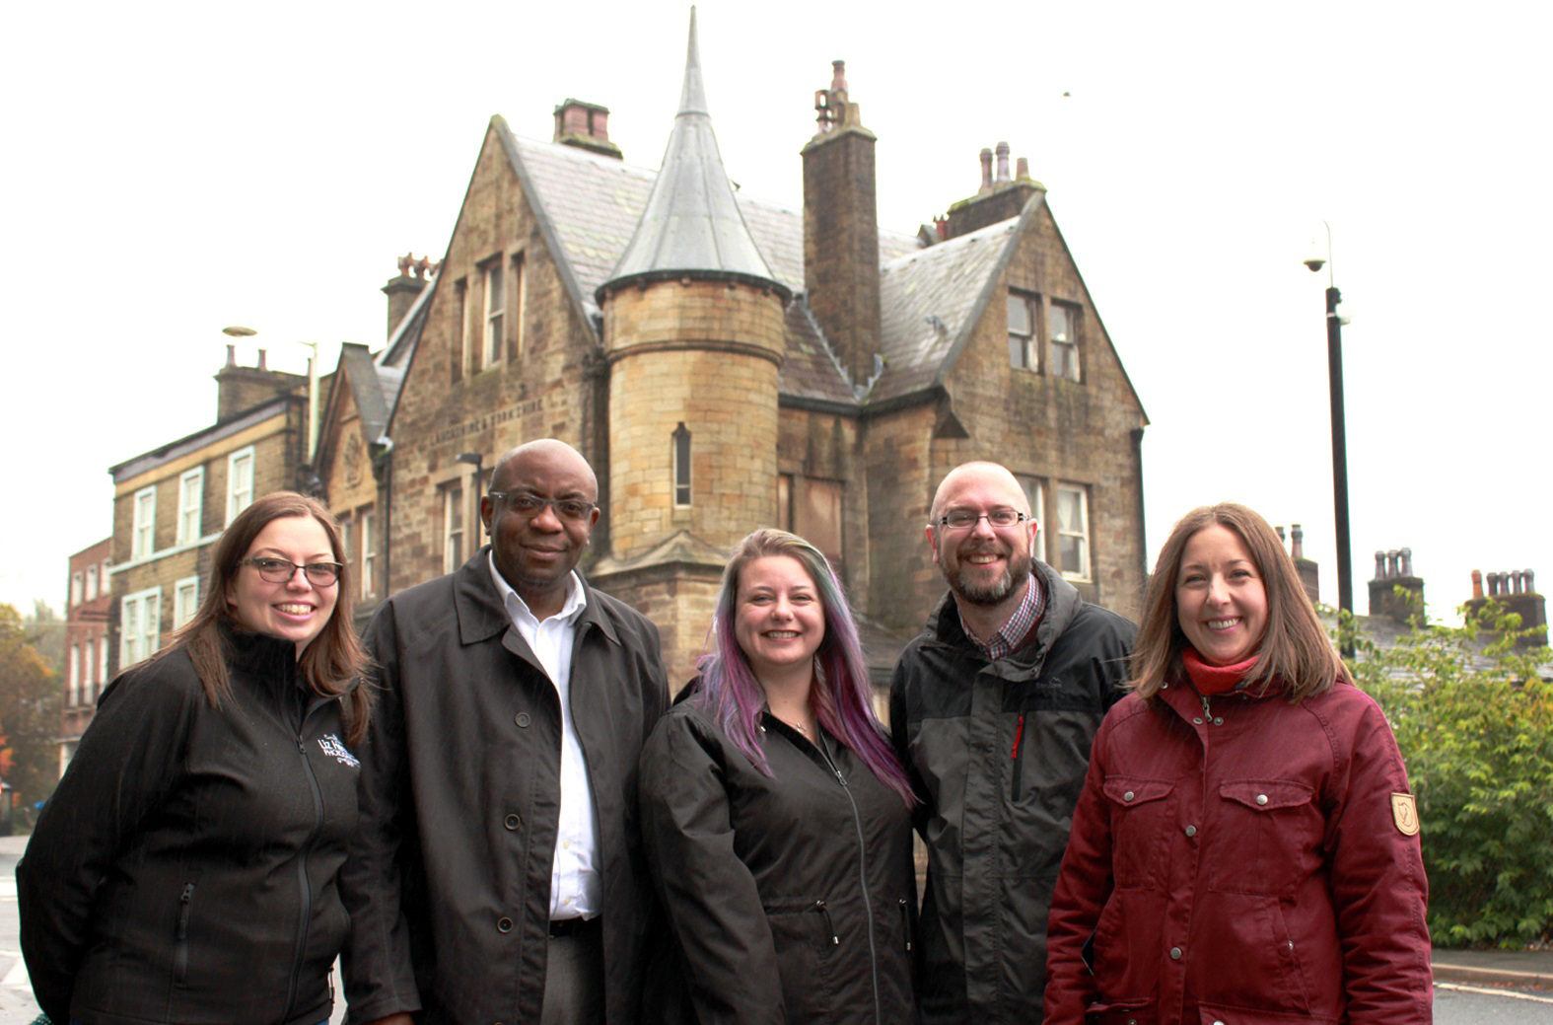
Case Study: Former Bank – Valley Heritage, North West
AHF support to date:
HIF Loan in 2019 £195,000
Capital grant in 2020 £311,271
Grade II 19th-century former bank converted into work spaces and accommodation units for young people at risk of homelessness

Slide 9
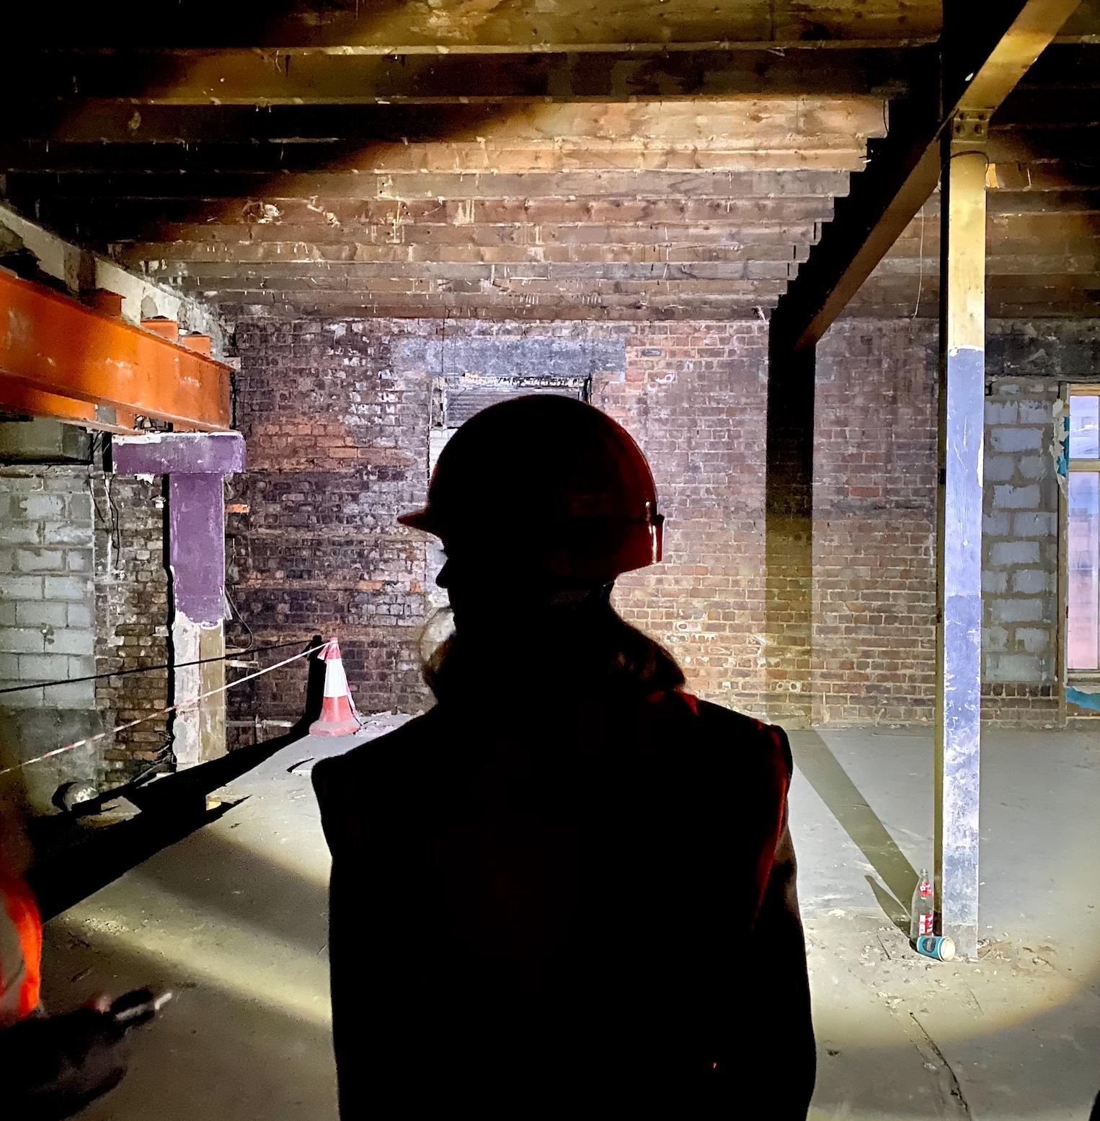
Our Partners
www.ahfund.org.uk

